Slide 1
Do the existence of baggage fees delay flights?
Cecilia Strombeck
Final Project Presentation
November 2014
GA Data Science

Slide 2
Hypothesis:
Fees on checked bags
➔ more carry-on bags
➔ filled overhead compartments
➔ delayed flights

Slide 3
Model & Approach:
Multiple Linear Regression Model
Outcome: Actual Flight Time – Target Time
Notes:
Count 213,427
Max 1,770
Min -53

Slide 4
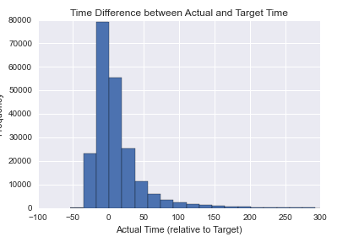
Model & Approach:
Notes:
Count 213,427
Max 1,770
Min -53

Slide 5
Model & Approach:
Multiple Linear Regression Model – Supervised Learning
Outcome: Actual Flight Time – Target Time
Features: Airport Dummies, Airline Dummies, 1st Checked Bag Fee Dummy
Time Delay = α + {Airport Origin Dummies} + {Airport Destination Dummies} + {1st Bag Fee Dummy}
Notes:
11 airlines

Slide 6
Problems and Assumptions:
Airlines can be operated by regional carriers: SkyWest, ExpressJet, Envoy Air.
Bag Fees:
  Not uniform for all passengers
  JetBlue introduced fees
  ~20% of flights without fee
Scheduled Time Differences
Diverted & Cancelled Flights
Limited to 20 routes
Seasonality

Slide 7
Results:
No statistical significance in any of the months
  Tried with different outcomes.
Why?
Boarding time extended
Small number of routes
Only 2 airlines without fee

Slide 8
Possible Next Steps:
More routes
Incorporate Cancelled and Diverted Flights
Method to combine 12 months
Baggage Fee as continuous, account for 2nd bag and/or carry-on fee.
Investigate delay reasons
Delay threshold ➔ logistic regression
Type of travel
Load factor
Additional variables

